Slide 1
Otorhinolaryngology OPD workflow

Slide 2
Location of RAK OPD

Slide 3
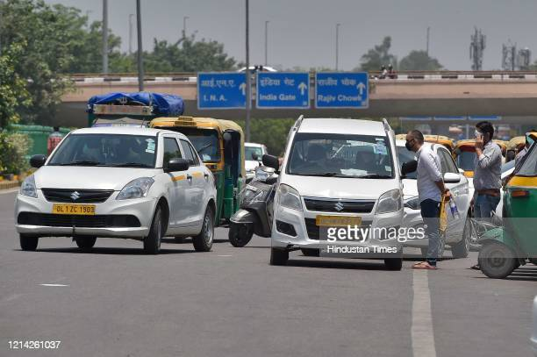
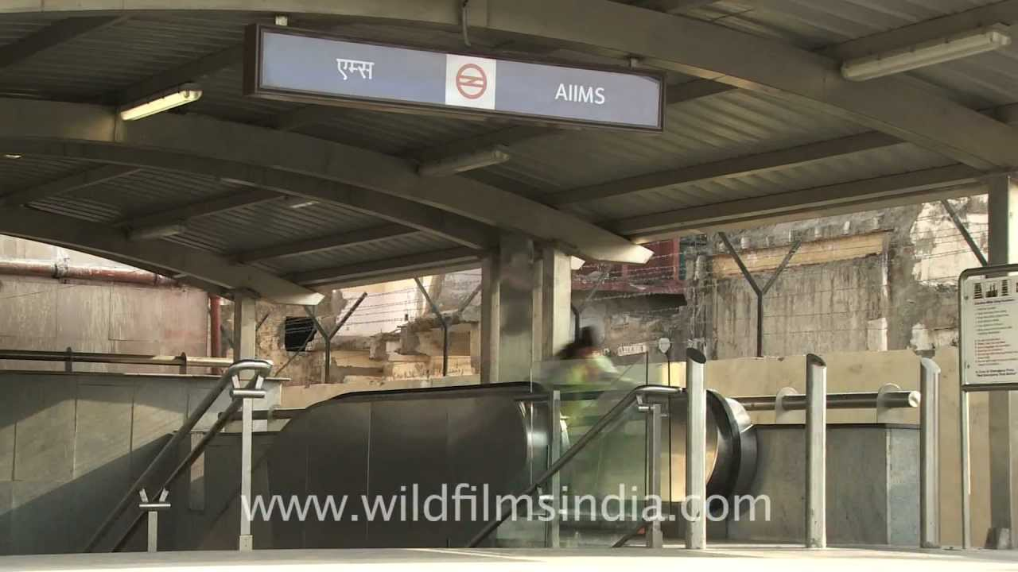
How to reach AIIMS, New Delhi

Slide 4
Transportation services in AIIMS from gates & parking areas

Slide 5
How to take appointments
AIIMS web portal
Counters at Gate number 1

Slide 6
Web portal for online appointments

Slide 7
New appointments

Slide 8
New appointments

Slide 9
Follow up

Slide 10
Location
ENT OPD- Old RAK OPD, 4th floor
Days- Monday to Saturday
Registration timing 8.30 am-10.30 am
Consultation timing 9.00am to 1 PM
(till the last patient)

Slide 11
continue
The patient is screened in OPD for COVID-related symptoms.
The patient is sent to their respective rooms
The patient may ask for investigations & follow-up visits if required
For investigations- the patient will be sent to the concerned department

Slide 12
ENT laboratories
Laboratory | Room No.
Audiomery, OAE | 4121
ABER, ASSR, | 4119
Cochlear Implant | 4121
Speech Therapy | 4119
VNG | 4062
Rhinomenometry | 4062
Stroboscopy, EMG | 4112
Trans-nasal oesophagoscopy | 4121
Apneography | D-4 ward

Slide 13
Faculty OPD schedule
Faculty | Days
Dr. Alok Thakar | Wednesday/ Saturday
Dr. Rakesh Kumar | Monday/ Thursday
Dr Kapil Sikka | Wednesday/ Saturday
Dr Amit Chirom Singh | Tuesday/ Friday
Dr. Rajeev Kumar | Monday/ Thursday
Dr. Prem Sagar | Tuesday/ Friday
Dr. Shuchita Singh Pauchari | Tuesday/ Friday
Dr. Arvind K Kairo | Monday/ Thursday
Dr. Hitesh Verma | Wednesday/ Saturday

Slide 14
Specialized clinics
Clinics | Days | Location
Vertigo Clinic | Monday (2.30-5 pm) | ENT OPD, Room No. 4115
Voice Clinic | Monday(2.30-5 pm) | ENT OPD, Room No. 4112
Rehabilitation clinic | Thursday (11 am) | ENT OPD, Room No. 4112
Head & Neck Clinic | Monday, Friday (2-5 pm) | IRCH, Room No. 2,3
Audiology & Skull base Clinic | Wednesday(2-5 pm) | ENT OPD, Room No. 4115
Cochlear implant clinic | Wednesday(2-5 pm) | ENT OPD, Room No. 4119
Rhinology & Facial Plastic Clinic | Friday(2-5 pm) | ENT OPD, Room No. 4115
Radiology clinic | Wednesday (2.30-4 pm) | Room number 52
Nuclear Medicine Clinic | 2nd,4th Friday of Month (11 am-12pm | Room number 15

Slide 15
Disclaimer
The content of the presentation is on best effort basis
Information in this presentation is as the current date (3/1/2022) and is subject to change with time.
Please your own judgment and information from other sources before relying on the presentation

Slide 16
Thank you

